Slide 1

entry points …to app development
Tim Benroeck timRND.com @TimBenroeck

Slide 2

app opportunity

Slide 3

entry points

Slide 4
App Development Entry Points
EASY
APP STUDIO
Windows Phone, Windows 8
EASY
PROJECT SIENA
Windows 8
EASY
TOUCH DEVELOP
Windows Phone, Windows 8, iOS, Android
SOSO
SOSO
Swift
iOS, OS X
C#
Windows Phone, Windows 8, iOS*, Android*
*via Xamarin
SOSO
JavaScript
Windows Phone*, Windows 8, iOS*, Android*
*via an embedded browser
HARD
HARD
C++
Windows Phone, Windows 8, iOS*, Android*
*via Marmalade
HARD
Objective-C
iOS, OS X
Java
Windows, OS X, Android
GAME ENGINES

Slide 5
Game Engines
EASY
EASY
GAME SALAD
Windows 8, iOS, Android, +more
CONSTRUCT2
Windows Phone, Windows 8, iOS, Android, +more
EASY
GAMEMAKER
Windows Phone, Windows 8, iOS, Android , +more
EASY
PROJECT SPARK
Xbox, Windows 8
EASY
CORONASDK
Windows Phone, Windows 8, iOS, Android, +more
SOSO
PHASER
Windows Phone, Windows 8, iOS, Android, +more
SOSO
UNITY
Windows Phone, Windows 8, iOS, Android, +more
SOSO
COCOS2D
Windows 8, iOS, Android, +more
SOSO
MONOGAME
Windows 8, Windows Phone 8 iOS, Android, +more
HARD
MARMALADE
Windows Phone, iOS, Android, +more

Slide 6
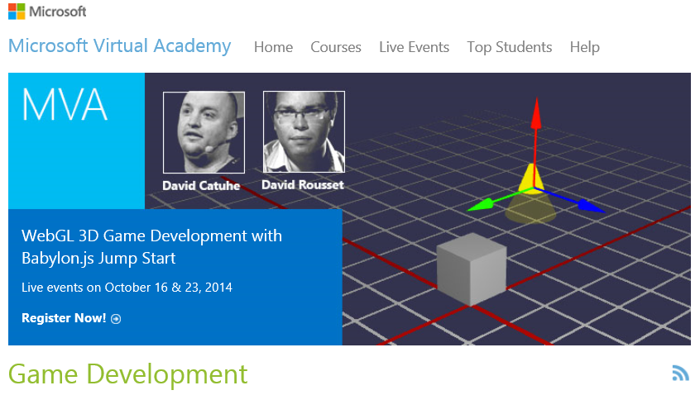
Microsoft Virtual Academy
Visit
MVA.MS

Slide 7
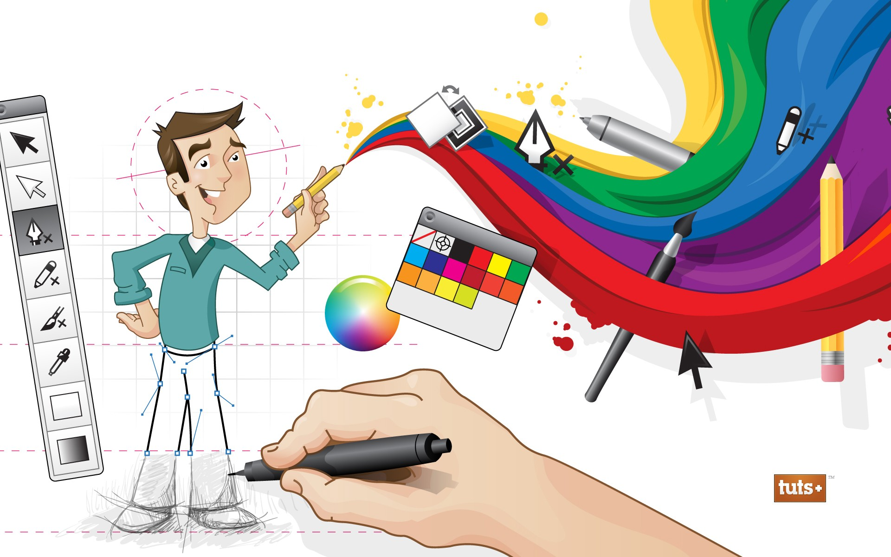
entry points
app art

Slide 8


free image editors
GIMP.ORG
INKSCAPE.ORG

Slide 9
game assets
Kenny Donation Pack: http://aka.ms/kenneyassets
Open GameArt: http://opengameart.org/
2d Game Art: http://2dgameartforprogrammers.blogspot.com/
More at http://codefoster.com/media

Slide 10

design

Slide 11
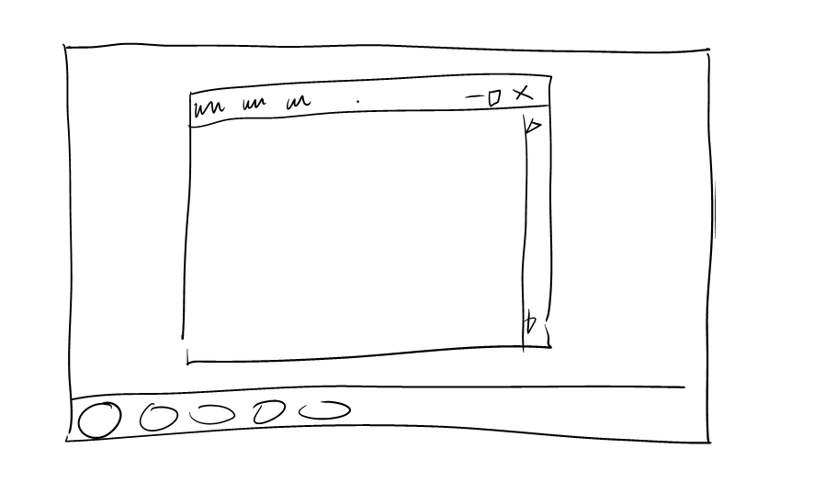
Notes:
SCRIPT
The UX team did an interesting survey. They asked users to draw their experience with traditional desktop applications. This is what users drew. It’s a fairly accurate representation of the essence of the desktop applications we’re all quite familiar with, but notice that mostly what we have is what we call chrome. We have means to launch content, means to execute commands against content, means to close content, and even the means to scroll content. What we don’t have is content.

Slide 12
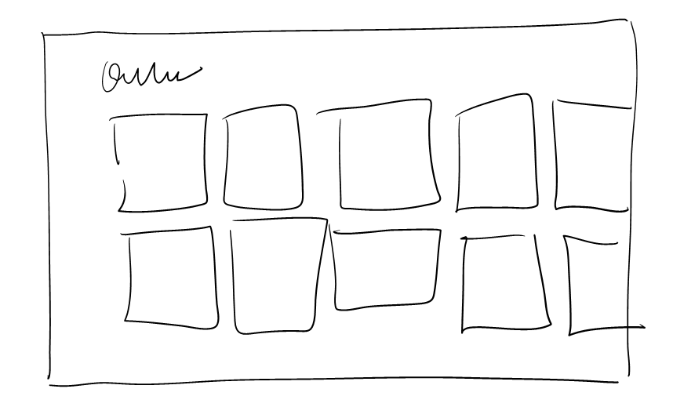
Notes:
SCRIPT
Then users were asked to draw their experience with Metro style apps and this is it.
Again it’s a fairly accurate depiction and what is it that is represented. It’s the actual content. This is because Metro style applications immerse the user in the content.
The shift in focus is crucial – it means that the users, instead of remembering how to use the software, are remembering the content – the news story they read about, the social updates from their friends, the products they are shopping for.

Slide 13
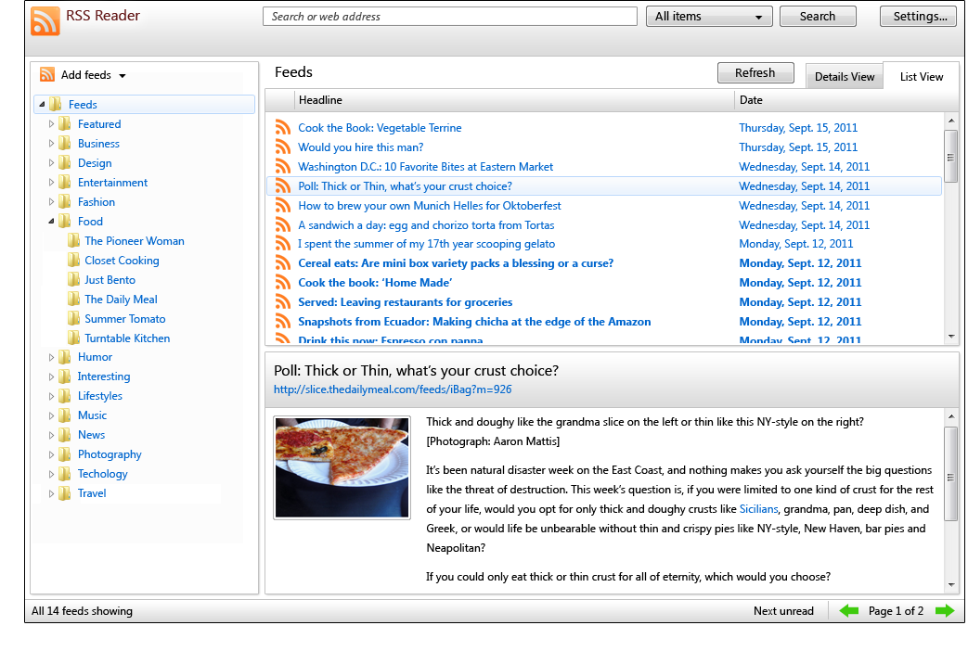
Notes:
SCRIPT
Let’s have a look at a traditional desktop application. It’s quite representative of desktop applications, so we should all recognize this application even if we haven’t used this one specifically.
Let’s take some time to notice the chrome in use here.
There are horizontal and vertical lines separating and attempting to layout content.
There are interactions everywhere – buttons to change pages or views, search buttons, and scroll bars.
Finally, most of the space is taken up telling the user about where he might possibly want to navigate. Hardly any is used to tell him about where he currently is.
Let’s see if we can improve this… [CLICK]

Slide 14
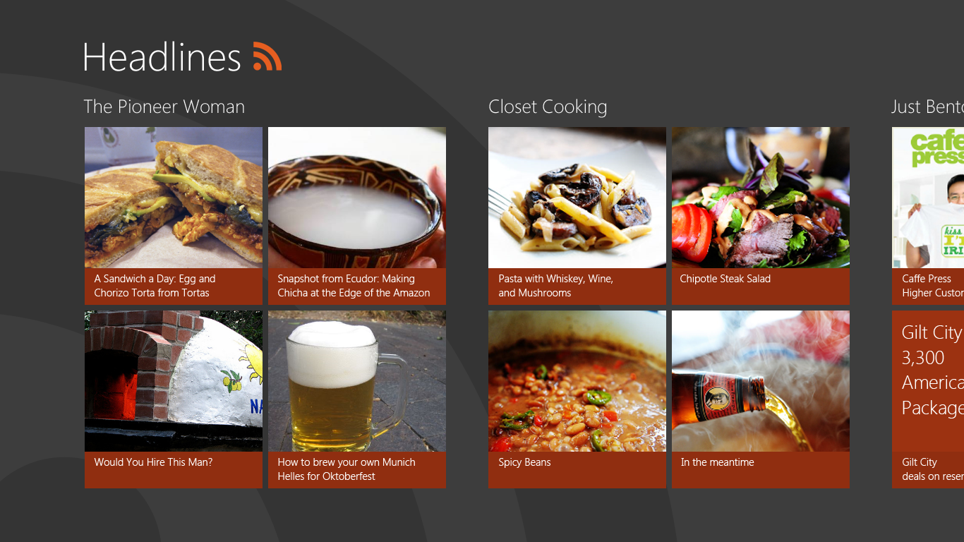
Notes:
SCRIPT
Here we go. Now our categories appear with their associated content and individual items highlight the image and title and invite the user to click them directly to read more.
This app is now acting as a great illustration of what we call the Metro silhouette.
[CLICK]
This overlay illustrates some of the layout prescribed by the silhouette. There should be a consistent amount of space around common screen element. The header, for instance, is always 100 pixels from the top of the screen, and all content is always 120 pixels from the left. There’s also room below and between content elements.
The silhouette also prescribes consistency of typography for the primary page elements. The header is 42pt, subheaders are 20pt, and body content is 11pt.

Slide 15
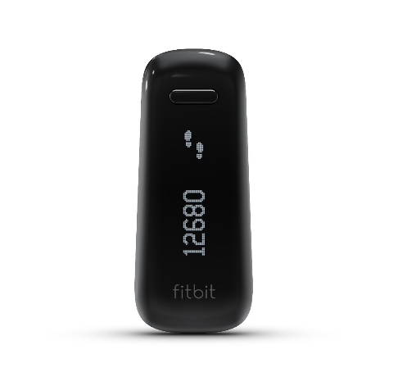
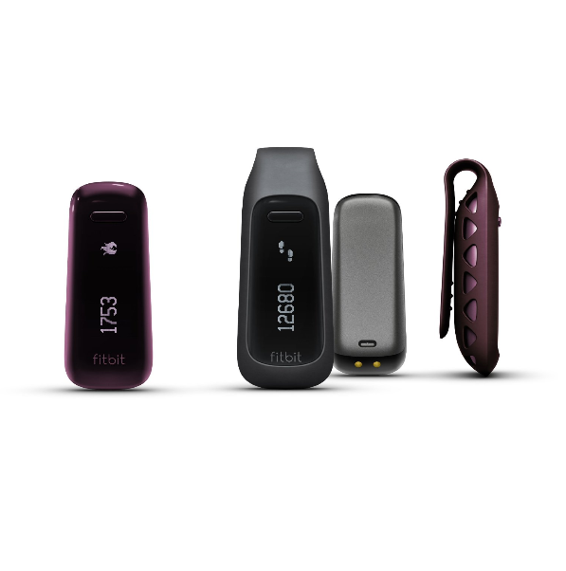
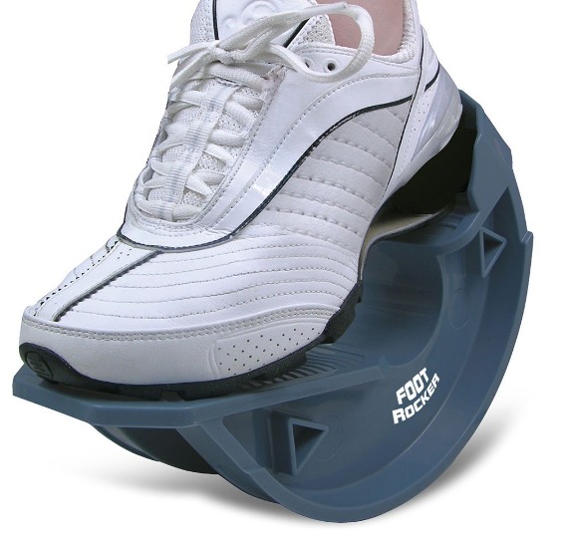
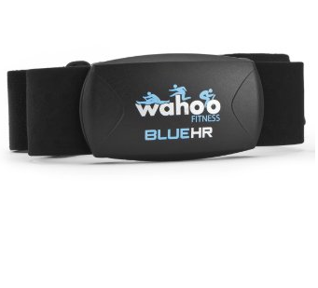
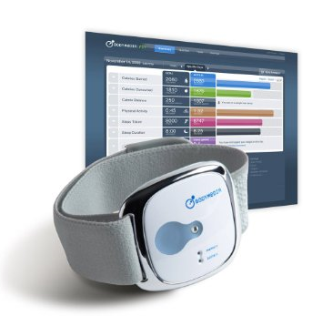




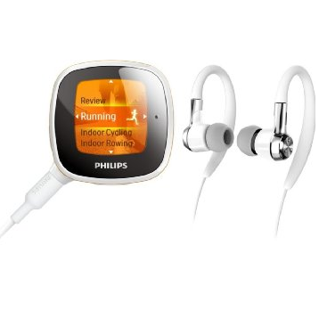
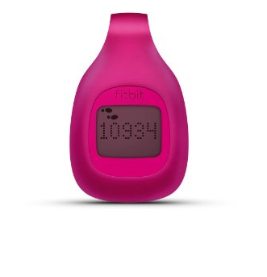
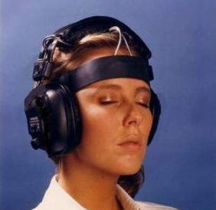
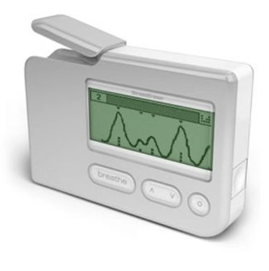
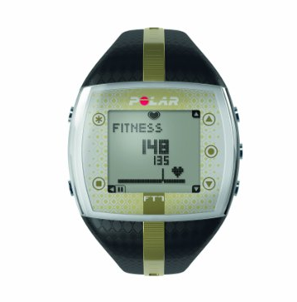
Product name
Product name
Product name
Product name
Product name
Product name
Product name
Product name
Product name
Product name
Product name
Product name
Product name
Product name
Product name
Product name
Product name
Product name
Product name
Product name
Notes:
SCRIPT
Next I want to show you why we should provide commands contextually.
In this slide we have a number of items and each has its own set of like, email, and download buttons.
Note that these repeating buttons take up valuable space but more importantly they are more visual noise than they are helpful.
Instead of repeating these buttons on each of the item [CLICK] we can move them to the app bar and show them when the user has made a selection of one or more of the items.

Slide 16
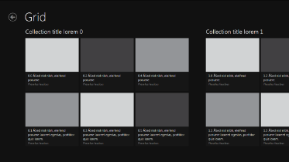
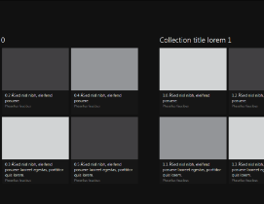
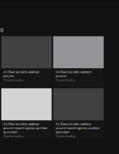
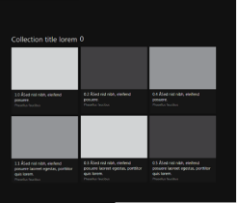
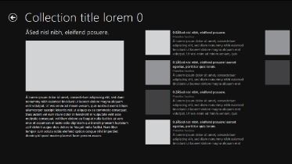
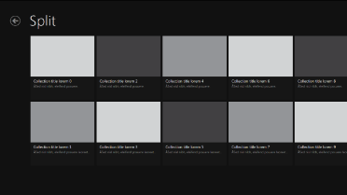
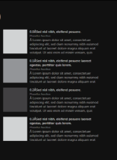


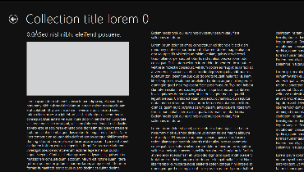


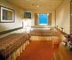



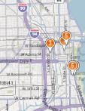
Hub
Contoso Travel
Featured destinations
Last minute deals
My Trips
City Guide
Sections
Featured Destinations
Last Minute Deals
My Trips
Top Destinations for 2012
Barcelona, Spain
7 night Alaska Cruise
Details
Featured destinations
Last Minute Deals
My Trips
Barcelona, Spain
7 Night Alaska Cruise
Chicago (3/11 – 3/19)
Weather 7 days
Attractions
Today
54/43 Mostly Sunny
Today
54/43 Mostly Sunny
Today
54/43 Mostly Sunny
Ocean View Cabins
Upgrade from an inside cabin and save $43/night/person!
Picture windows with ocean and port views
From $2,099 — only $150/night/person based on double occupancy
Suites
Upgrade from an inside cabin and save $43/night/person!
Picture windows with ocean and port view
From $2,099 — only $150/night/person do
Today
54/43 Mostly Sunny
Today
54/43 Mostly Sunny
Notes:
UI Structure

Slide 17

DEMO
appstudio.windows.com

Slide 18
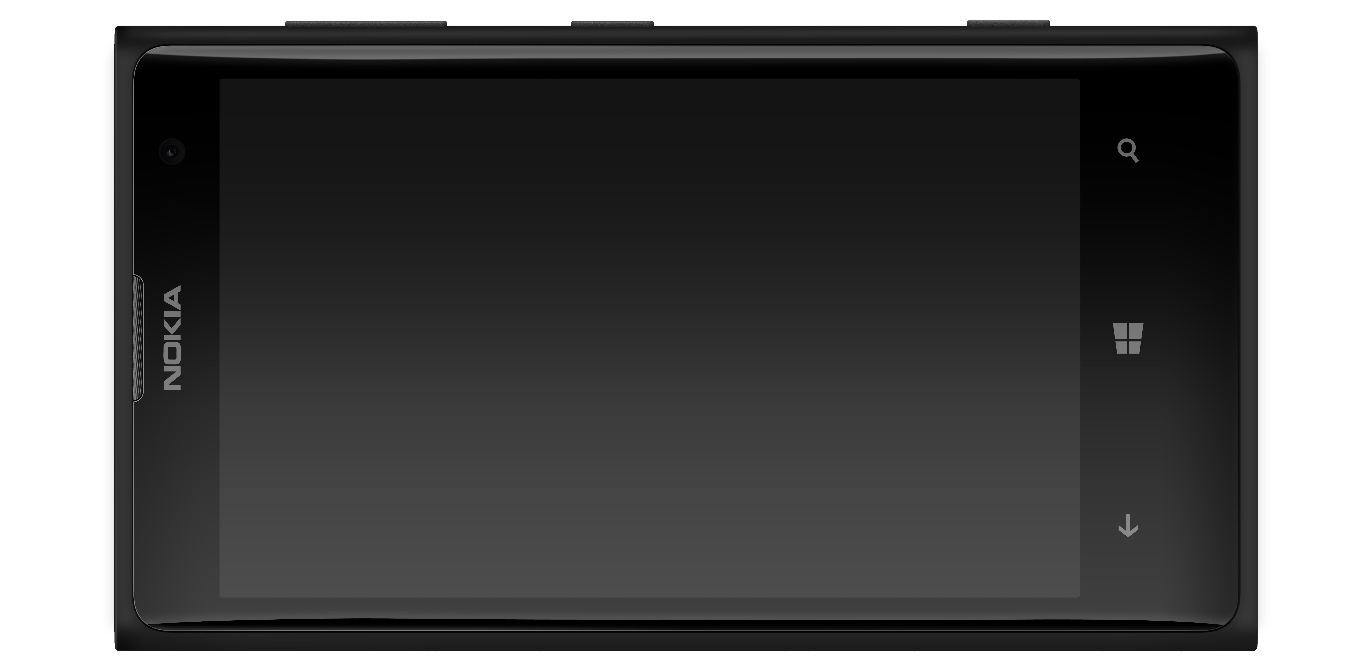
phone

Slide 19
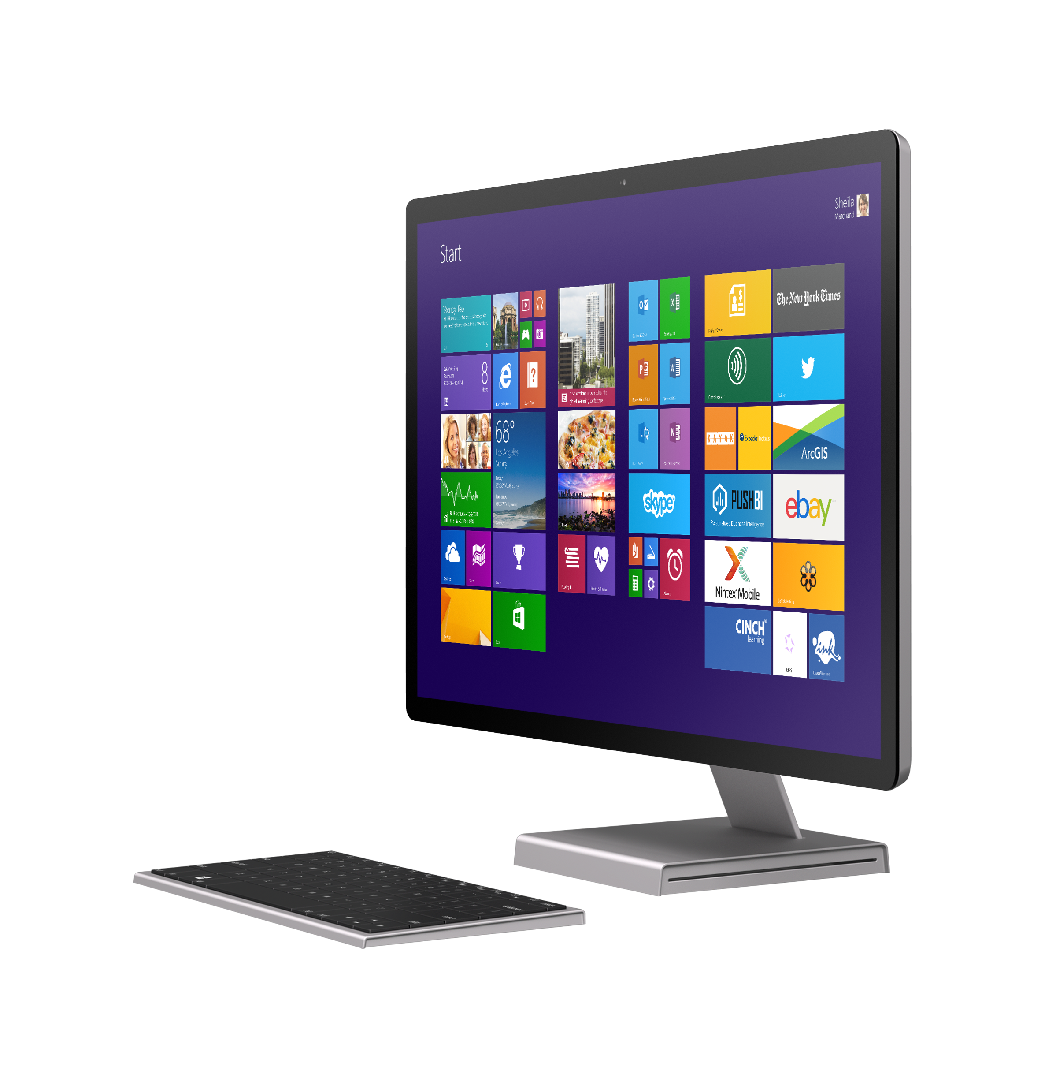
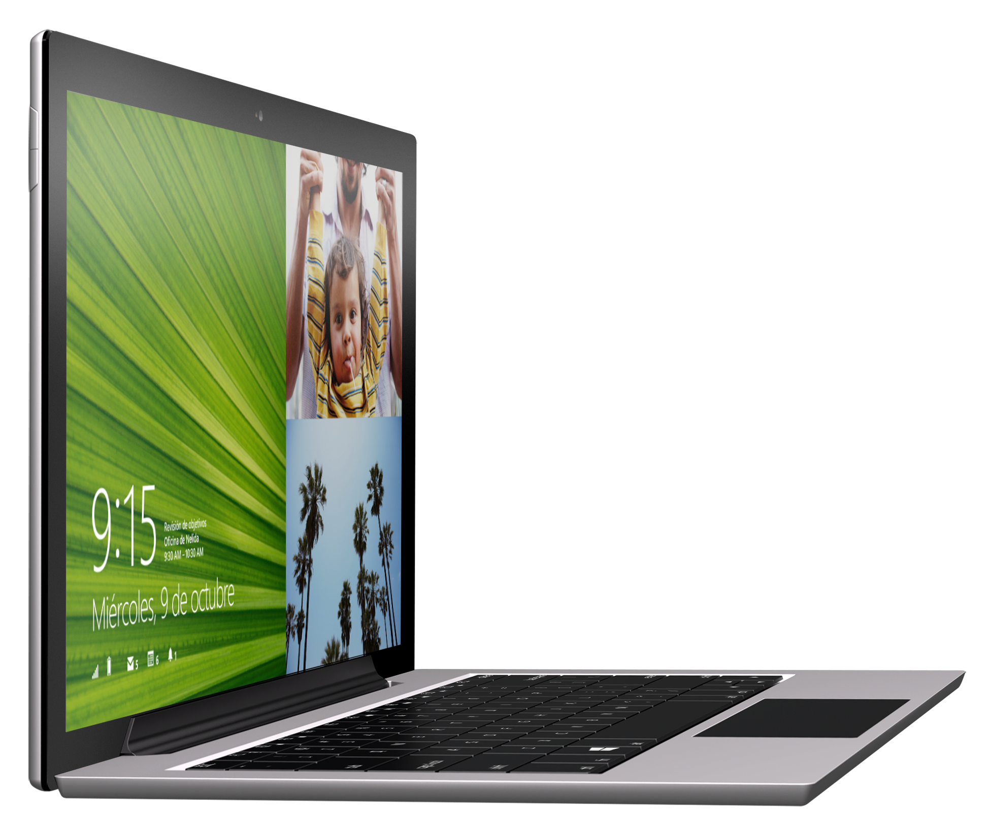
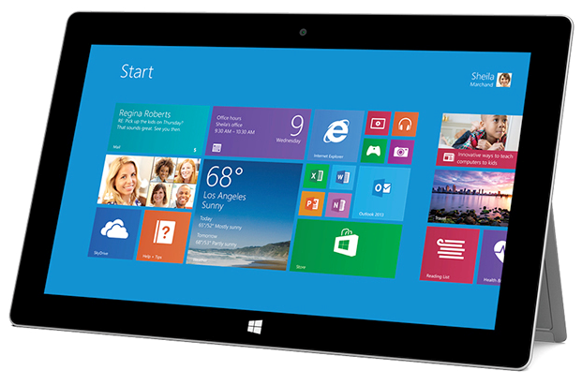
tablet/desktop

Slide 20
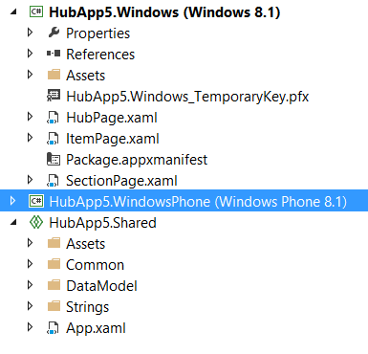
Universal Apps

